Slide 1

Fundamentals of Artificial Intelligence
Farian S. L Ishengoma

Slide 2




Chapter three

Slide 3
Problem solving
Problem solving process.
Problem types and characteristics
Problem analysis and representation
Formulating problems
Searching for solution
Uninformed search
Informed (heuristic) search.
Performance measuring

Slide 4

Problem solving process.
Every problem is defined in a context
In this context, it has certain assumptions under initial conditions.
Every problem has a well-defined objective
Solution to every problem consists a set of activities
Each activity changes the state of problem, i.e., from the present state to the new state.
This new state is closer to the solution state.
Finally, initial state approaches the goal situation.
Previous knowledge and domain knowledge both are used as the resources during different states in the solution process
Note KB = Knowledge base system

Slide 5
Problem types and characteristics
Problems can be categorized into different types that are:
Deterministic or observable
Non-observable
Non-deterministic or partiality observable
Unknown state space

Slide 6
Deterministic / observable:
A deterministic or observable problem in machine learning refers to a problem where the outcome is known or predictable with certainty, given a specific input.
The model can make accurate predictions because the relationship between the input and output variables is well-defined and easily quantifiable.
For instance, consider a simple problem of predicting the temperature of a room given the current temperature, the current humidity, and the current time of day. If we have a dataset with these parameters and their corresponding temperatures, we can train a machine learning model to predict the temperature accurately for any input combination of these parameters.

Slide 7
Non-observable
In non-observable problems in machine learning there is no clear relationship between the input and output variables, and the output cannot be accurately determined for any given input.
To solve these problems, more sophisticated machine learning algorithms are needed, such as deep learning, reinforcement learning, or probabilistic graphical models, which can handle the complexity and variability of the input data.
Example of a non-observable problem in machine learning is speech recognition, where the goal is to transcribe spoken language into written text.
Speech is highly variable and can be affected by many factors such as accent, background noise, and speaker variability.
These factors make it difficult to predict the output with certainty, and the model may make errors in its predictions.

Slide 8
Non-deterministic / partially observable
Partially observable problems in machine learning refer to situations where the model only has access to incomplete or partial information about the input data, making it difficult to predict the output with certainty.
In these problems, there may be hidden or unobserved variables that influence the output, and the model must assume their values based on the available input data.
To solve these problems, techniques such as Bayesian inference, reinforcement learning, or hidden Markov models may be used to model the uncertainty and make predictions based on incomplete information.
For example, consider a problem of predicting the weather based on satellite images. The model may only have access to partial information about the weather, such as cloud cover, wind speed, and temperature, but not all the relevant variables such as air pressure, humidity, or precipitation.
In this case, the model must assume the missing variables based on the available information and make a prediction about the weather.

Slide 9
Unknown state space
Unknown state space problems refer to situations where the model does not have complete information about the possible states of the input data, making it challenging to predict the output with certainty.
In these problems, the state space of the input data is not known, and the model must learn to make predictions based on incomplete information.
To solve these problems, techniques such as unsupervised learning, clustering, or anomaly detection may be used to identify patterns in the input data and make predictions based on these patterns. However, these techniques may not always be accurate or reliable, and there may be a risk of false positives or false negatives.
Example of an unknown state space problem in machine learning is fraud detection in financial transactions. The model may not have complete information about all of the possible types of fraud that can occur in financial transactions, making it challenging to predict the output with certainty.
In this case, the model must learn to detect fraudulent patterns in the input data and make predictions based on these patterns, even if it has not seen them before.

Slide 10

Problem analysis and representation
Problem analysis and representation in machine learning are critical steps in building effective machine learning models (H/w individual).
They involve:
Identifying the problem
Selecting relevant data
Formulating the problem
Representing it in a suitable form and
Evaluating the performance of the solution.

Slide 11

Uninformed search
Uninformed search is a type of search algorithm that does not use any domain-specific knowledge to guide its search.
It blindly searches the problem space until it finds a solution.
The uninformed search algorithms start from the initial state of the problem and systematically explore all possible states until a goal state is found.
The search process is guided by a set of rules or operators that allow the algorithm to move from one state to another.
At each step, the algorithm evaluates the current state and generates all possible next states.
The algorithm then selects the next state to explore based on a certain criterion, such as the depth of the search, the cost of the path, or the breadth of the search.

Slide 12
Group Assignment. 2
Types of uninformed search algorithms
Breadth First Search (BFS)
Uniform Cost Search (UCS)
Depth First Search (DFS)
Depth Limited Search (DLS)
Iterative Deepening Search (IDS)
Bi-directional Search
Groups should discuss these points as described in Chapter 3 of the reference book = Group Assignment. 2

Slide 13
Breadth First Search
Breadth First Search (BFS) is a graph traversal algorithm that explores all the vertices at the current depth before moving on to the vertices at the next depth level.
It starts at a given node (called the root node) and visits all its neighbors first before moving on to the next level of nodes.

Slide 14
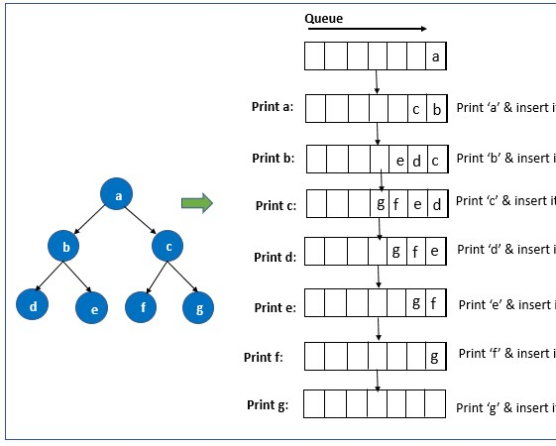
BFS

Slide 15

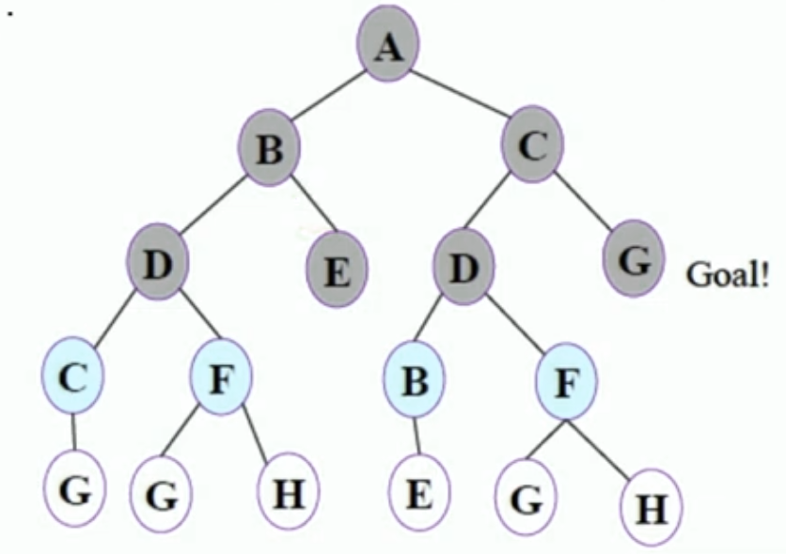

bfs

Slide 16
Real life example
Suppose you are a delivery person who needs to deliver packages to various locations in a city. You have a map of the city with the locations of all the delivery destinations. You want to find the shortest path to deliver all the packages and return to the starting point.
You can model the city map as an undirected graph, where each delivery location is a node and the roads connecting them are edges. To find the shortest path, you can use the BFS algorithm starting from your current location as the root node. The algorithm will visit all the nodes at the current distance level (i.e., all the delivery locations that are one road away from your current location) before moving on to the next level of nodes (i.e., all the delivery locations that are two roads away from your current location), and so on.
In this way, BFS will help you explore the entire city map and find the shortest path to deliver all the packages and return to the starting point. Moreover, BFS can also help you optimize your delivery route by considering the traffic conditions and other constraints

Slide 17
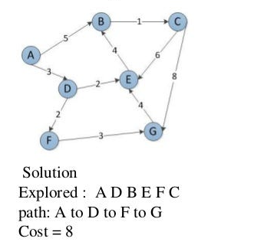
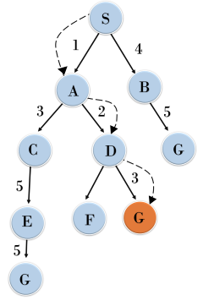
Uniform Cost Search
Uniform Cost Search (UCS) is a graph traversal algorithm that is used to find the lowest-cost path from a starting node to a goal node in a weighted graph

Slide 19
Real life example
Suppose you are planning a road trip from your current location to a distant city. You have a map of the region with the distances between all the cities and towns along the way. You want to find the shortest path to your destination, considering the costs associated with traveling different distances and using different routes.
You can model the map as a weighted graph, where each city or town is a node and the distances between them are the edge weights. To find the lowest-cost path to your destination, you can use the UCS algorithm starting from your current location as the root node. The algorithm will visit all the nodes at the current cost level (i.e., all the cities and towns that are at the same distance from your current location) before moving on to the next level of nodes with higher costs.
In this way, UCS will help you explore the entire map and find the lowest-cost path to your destination. Moreover, UCS can also help you optimize your route by considering the costs of different modes of transportation, such as fuel prices, and travel time.

Slide 20
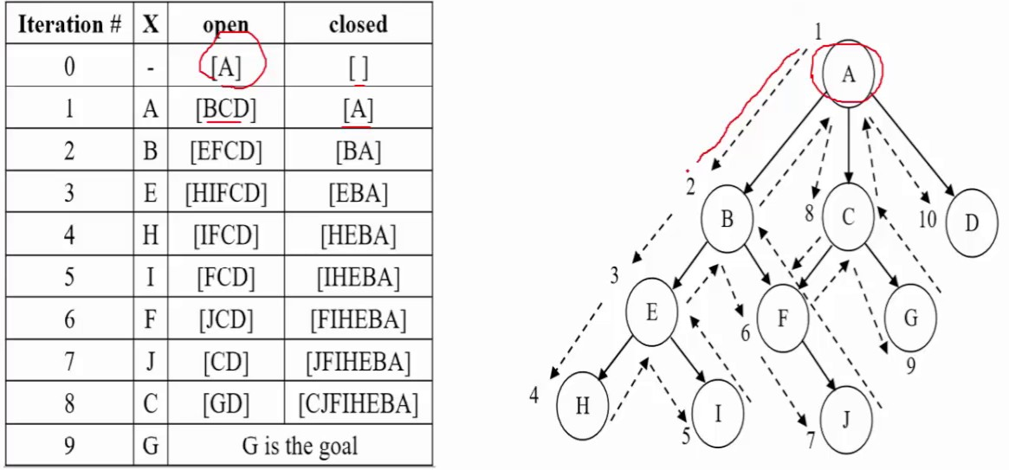
Depth First Search
Depth First Search (DFS) is a graph traversal algorithm that explores as far as possible along each branch before backtracking
It is important to note that DFS does not guarantee that you can explore every possible path, as it only explores one branch at a time and may miss some paths altogether.

Slide 21
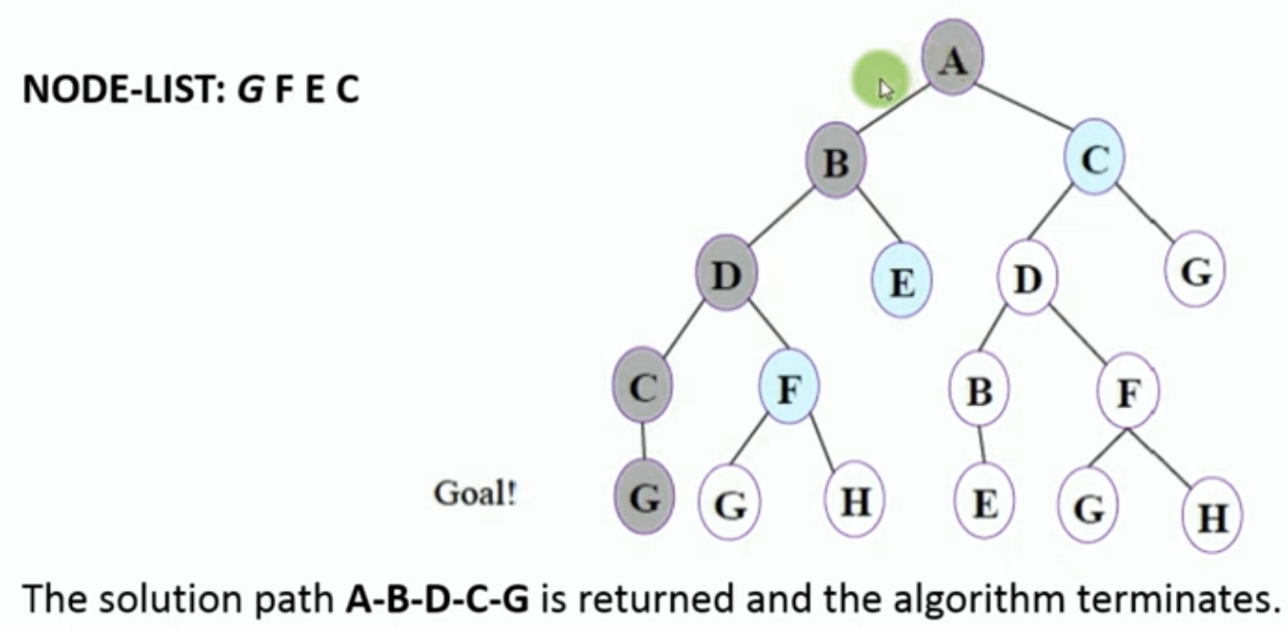
DFS

Slide 22
Real life example
Suppose you are a librarian, and you want to organize your collection of books in a way that makes it easy for patrons to find what they are looking for. You have a large number of books on various subjects, and you want to group them together based on their topic.
You can model the books as nodes in a graph, and the topics as edges that connect them. For example, a book about history might be connected to other books about history, as well as books about geography, politics, and economics.
To group the books together, you can use DFS to explore the graph and find all the books that are connected to each other based on their topic. Starting from a random book, you can follow its edges to other books on the same topic and continue to explore the graph in a systematic way.
By using DFS, you can efficiently group the books together based on their topic and create a classification system that makes it easy for patrons to find what they are looking for. Moreover, DFS can also help you identify gaps in your collection and suggest new books to acquire based on the topics that are missing or underrepresented.

Slide 23
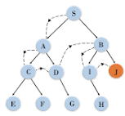
Depth Limited Search
Depth Limited Search (DLS) is a graph traversal algorithm that explores a graph up to a certain depth limit.
When a certain level is reached, the search ceases.

Slide 24
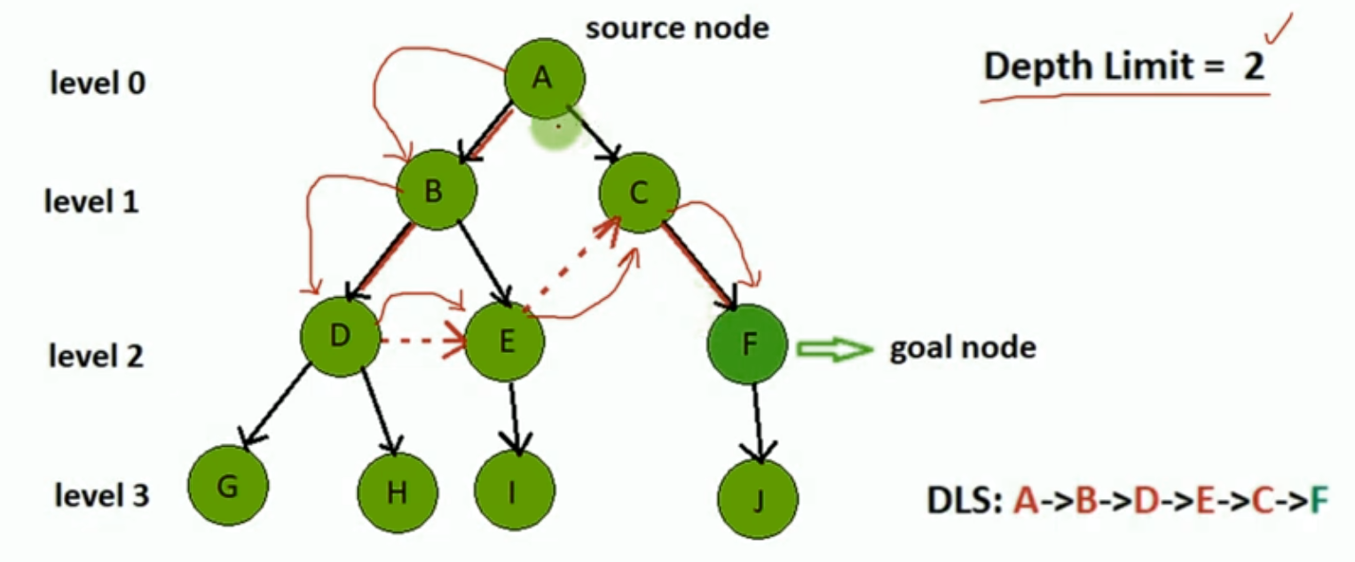
dls

Slide 25
Real life example
Suppose you are a tourist visiting a new city and you want to explore the city by taking a sightseeing bus tour. The tour has multiple stops, and you want to see as many landmarks as possible, but you only have a limited time before your flight departs.
To maximize your sightseeing experience, you can use DLS to explore the city's landmarks up to a certain depth limit. Starting from the bus stop, you can visit the landmarks that are within a certain distance from the stop and continue to explore the city in a systematic way.
For example, you can set a depth limit of three stops, which means you will visit the landmarks that are within three stops from the bus stop. After visiting these landmarks, you can return to the bus stop and take the next bus to visit the landmarks that are within the next three stops.

Slide 26
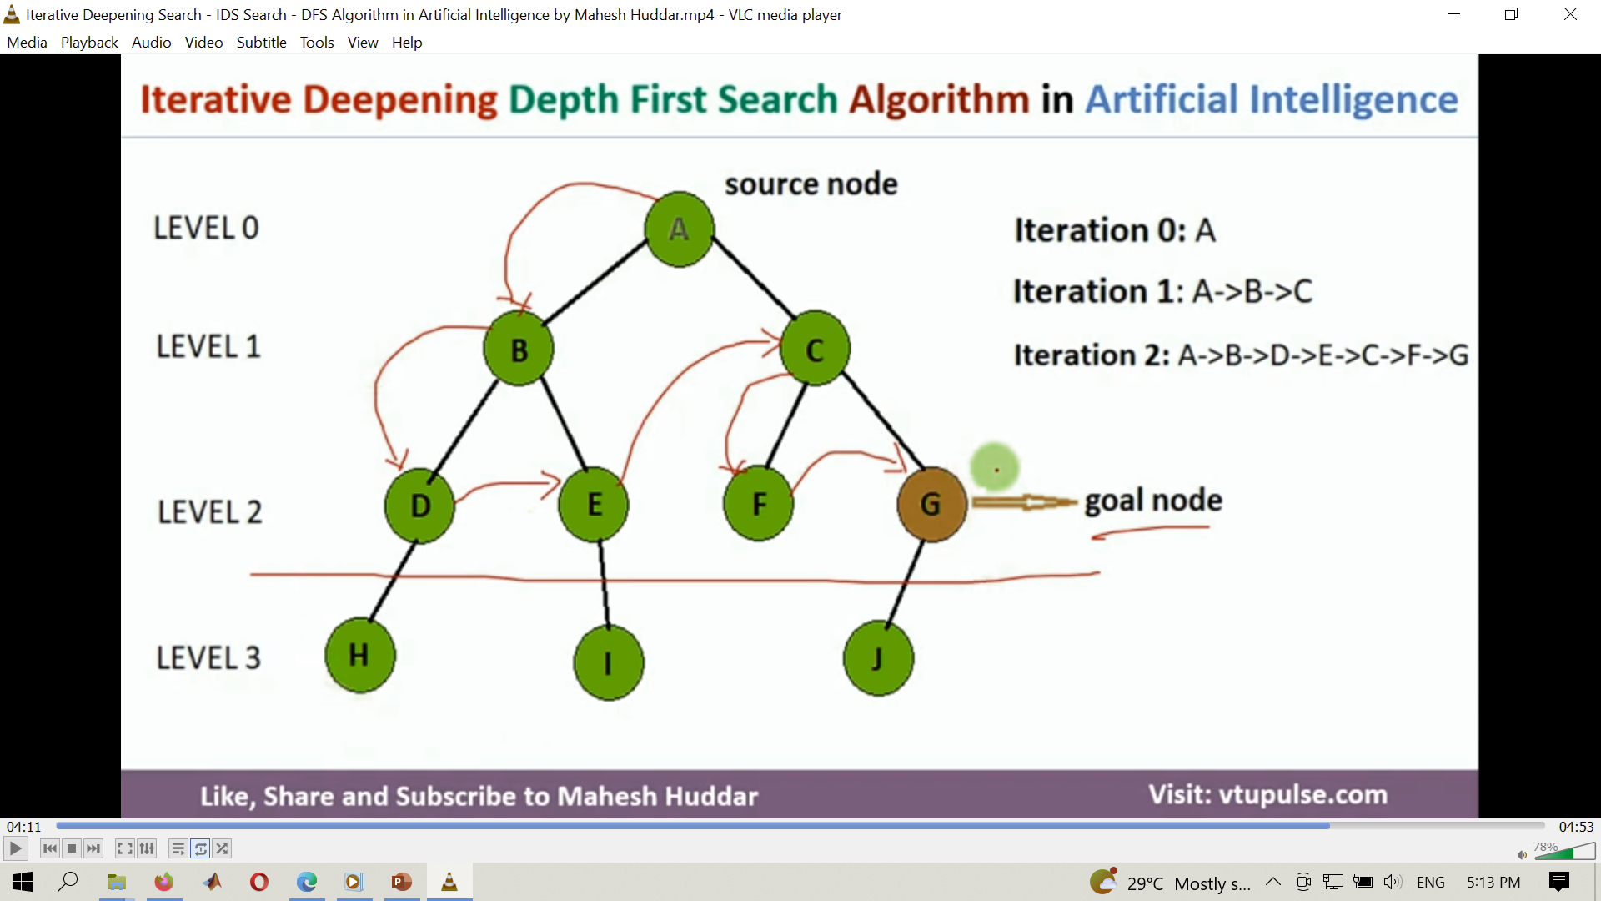
Iterative Deepening Search
Iterative Deepening Search (IDS) is a graph traversal algorithm that combines the benefits of both Depth First Search (DFS) and Breadth First Search (BFS) algorithms.

Slide 27
ids

Slide 28
Real life example
Suppose you are a rescue worker who needs to search for a missing person in a large and complex building. The building has multiple floors, rooms, and corridors, and the missing person could be anywhere. You want to explore the building systematically and efficiently, while minimizing the risk of missing any areas.
To accomplish this, you can use IDS to search for the missing person up to a certain depth limit, gradually increasing the limit until you find the person. Starting from the entrance or the last known location of the person, you can explore the rooms and corridors that are directly accessible up to a certain depth limit. If the person is not found within that limit, you can return to the starting point and increase the limit by one and repeat the process until the person is found.
By using IDS, you can explore the building systematically and efficiently, while minimizing the risk of missing any areas. Moreover, IDS can help you optimize your search strategy by gradually increasing the depth limit, based on the complexity of the building and the available resources.

Slide 29
Bi-directional Search
Bi-directional search is a search algorithm that starts searching simultaneously from both the start and goal nodes, and searches for a common node that connects the two searches in the middle.
The algorithm starts by initializing two search frontiers, one from the start node and one from the goal node.
Each search frontier is an ordered list of nodes, where the ordering is based on the estimated distance from the node to the start or goal node.

Slide 30
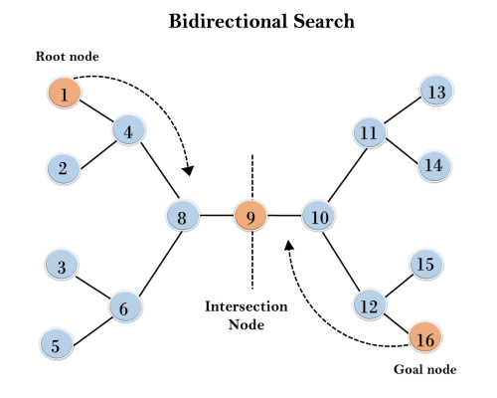
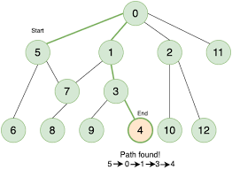
Bi-directional Search

Slide 31
The real-life example
Suppose you want to find the shortest distance between two cities. Instead of exploring the entire map and calculating the distances between every pair of cities, you can use bi-directional search to find the shortest path more efficiently.
To do this, you can start searching from both cities simultaneously, one going forward and the other going backward. Each search explores the adjacent cities of the current city, and the two searches meet in the middle when they have explored the same city. The shortest path is then the sum of the distances from the starting city to the meeting point and from the ending city to the meeting point.
By using bi-directional search, you can explore the cities more efficiently and reduce the search space by half, since you only need to explore the cities that are reachable from both directions. This can be especially useful when the map is large and complex, and exploring every possible path would be computationally expensive.

Slide 32

Break

Slide 33
Informed (heuristic) search.
Informed Search is a type of search algorithm used in machine learning that involves using problem-specific knowledge or heuristics to guide the search towards the goal state.
The heuristic function provides an estimate of the distance or cost from the current state to the goal state, allowing the algorithm to prioritize the search and explore more promising paths.
In machine learning, heuristic search is used to optimize various algorithms such as decision trees, neural networks, and reinforcement learning.
Heuristic search algorithms are widely used in many applications, such as
Route planning,
Game playing, and
Natural language processing.

Slide 34
heuristic search in ML
The common types of heuristic search in ML are:
Best-first search
Hill climbing
Beam search
Simulated annealing
Genetic algorithms
Tabu Search
Particle Swarm Optimization
Groups should discuss these points as described in Chapter 4 of the reference book = Group Assignment. 3

Slide 35
Best-first search
Best-first search algorithm uses a heuristic function to evaluate the nodes in the search space and selects the one with the best heuristic value as the next node to expand.
Examples of best-first search algorithms include
A* search
Greedy best-first search
Recursive best-first search

Slide 36
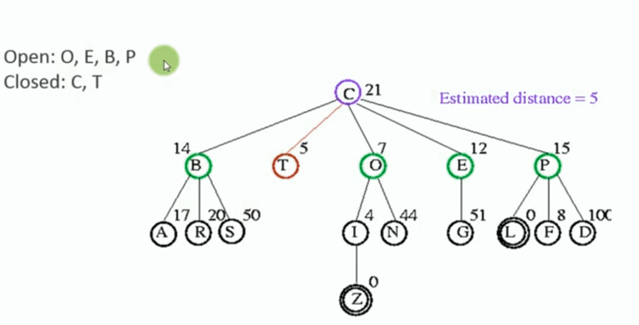
bfs

Slide 37
Real life examples
A real-life example of Best-first search is route planning in a GPS navigation system. When you input your destination in a GPS navigation system, it uses Best-first search to find the shortest path to the destination. The algorithm works by starting from the current location and exploring the neighboring roads to find the most promising road that leads towards the destination.
The heuristic function used in this case is the estimated distance to the destination, based on the geographic coordinates of the current location and the destination. This allows the algorithm to prioritize roads that are closer to the destination and avoid roads that lead away from the destination.
As the algorithm explores the neighboring roads, it keeps track of the path that leads to each road and their estimated distance to the destination. It then selects the road with the lowest estimated distance and continues the search from there.
This process is repeated until the algorithm reaches the destination, at which point it traces back the path that leads to the destination and presents it to the user as the shortest route.

Slide 38
Examples of best-first Algorithm
A* search algorithm
is a popular search algorithm that uses both the cost of reaching a node and the heuristic estimate of the cost to the goal to select the next node to expand.
It is commonly used in pathfinding problems in video games, robotics, and transportation planning.
For example, A* can be used to find the shortest path between two locations on a map, considering obstacles and terrain features.
Greedy best-first search
is an algorithm that selects the node that appears to be closest to the goal according to the heuristic function.
It can be very fast but may not find the optimal solution.
It is often used in problems where finding an approximate solution quickly is more important than finding the best solution.
For example, it can be used to find approximate solutions to the traveling salesman problem, where the goal is to find the shortest possible route that visits a given set of cities.

Slide 39
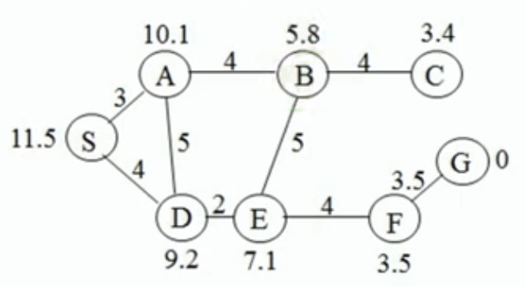
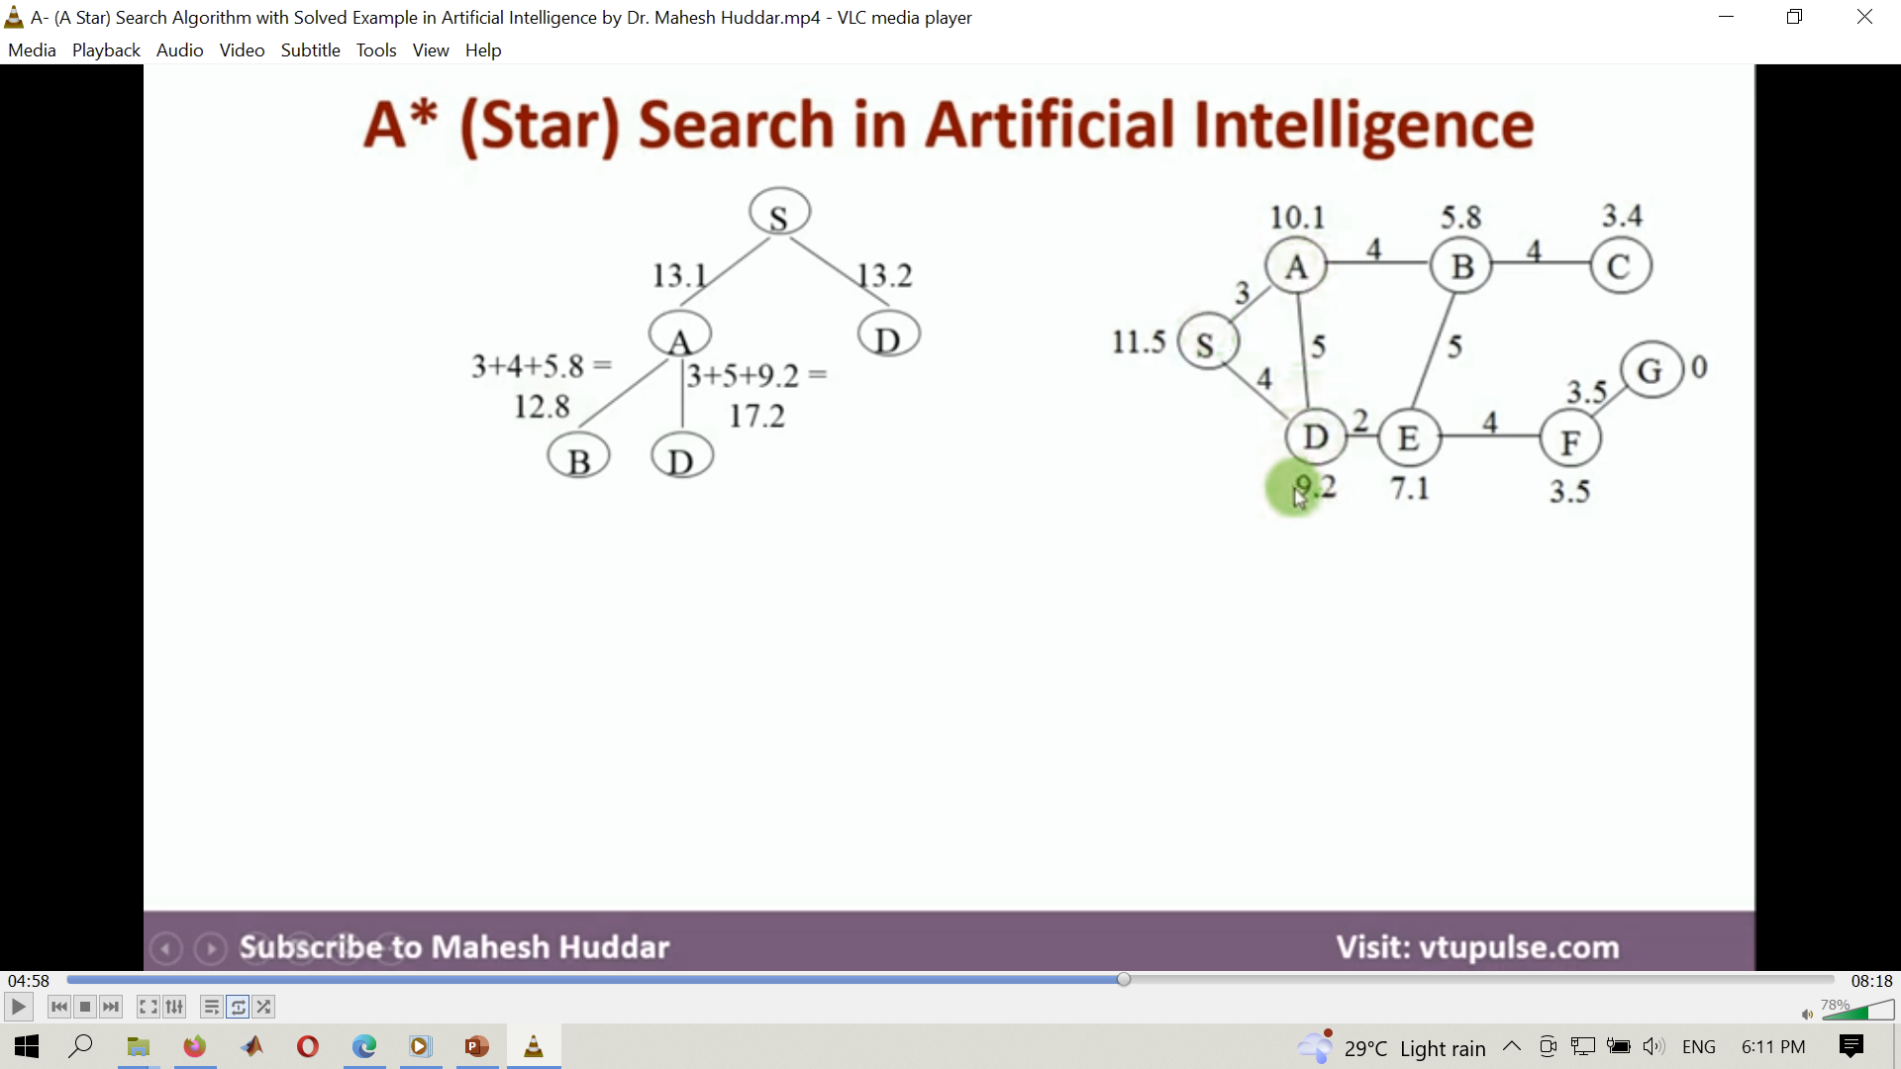
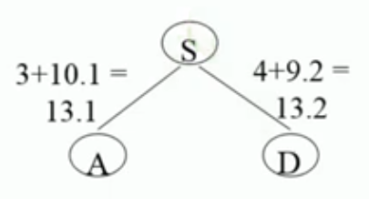
A* search algorithm
Function f(n) = g(n) + h(n)
f(n) = Function
g(n) = Cost of cheapest path from the goal state to node n
h(n) = Cost of cheapest path from the node n to a goal state

Slide 40
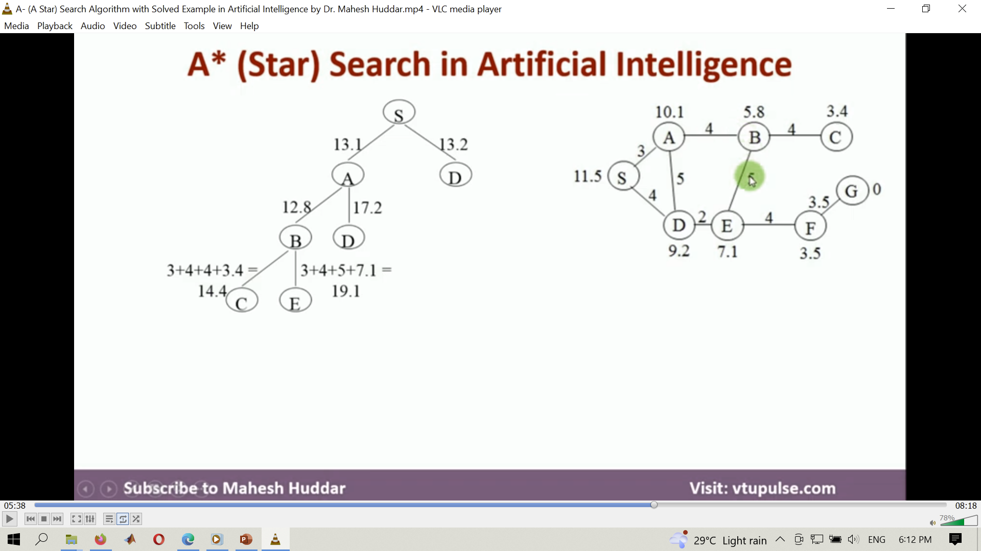
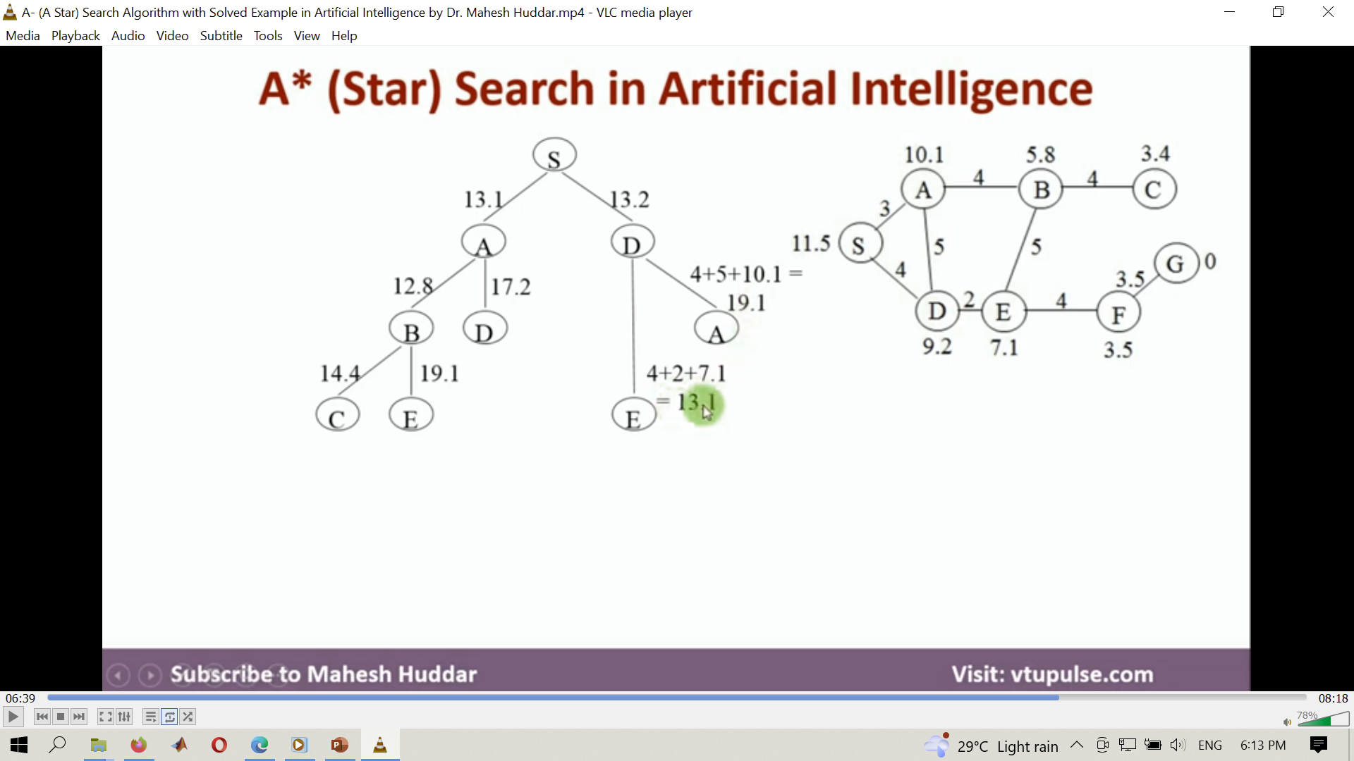
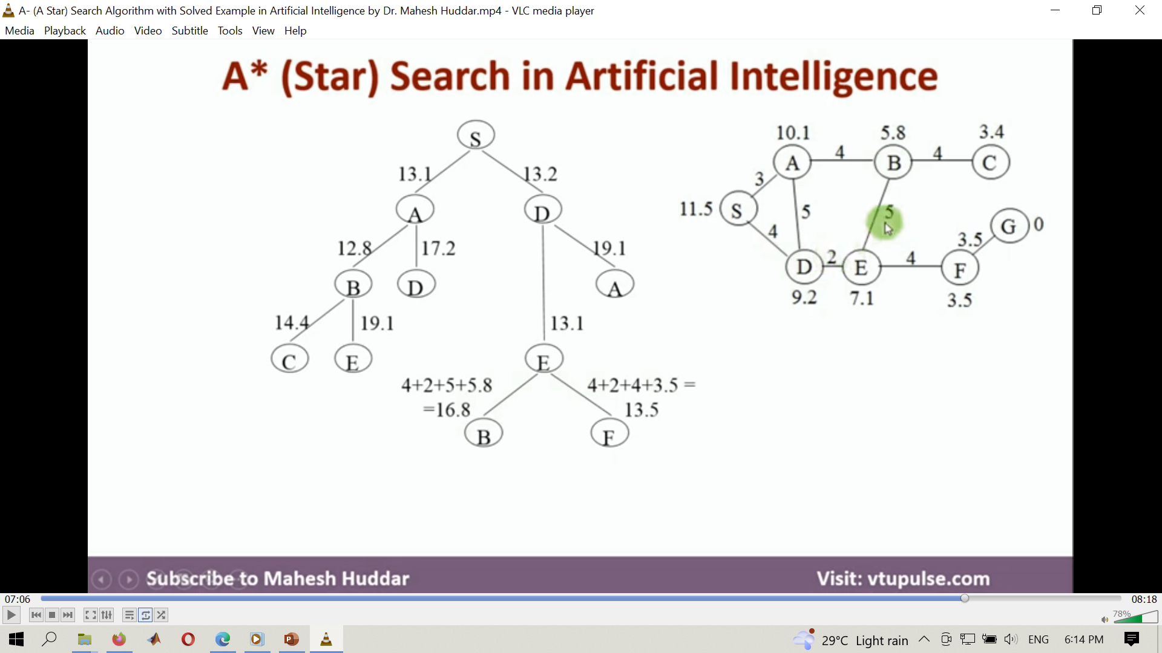
A* search algorithm

Slide 41
Examples of best-first Algorithm
Recursive best-first search
Recursive best-first search is like IDA* but uses a recursive strategy to keep track of the best path found so far.
It can be more efficient than IDA* for some problems but requires more memory.
Recursive best-first search is commonly used in problems where the search space is very large and memory constraints are not a major issue.
For example, it can be used in natural language processing to generate text by recursively selecting the most likely next word based on a language model.

Slide 42
Hill Climbing:
It is a simple optimization algorithm that starts with an initial solution and iteratively improves it by making small modifications.
In each iteration, the algorithm evaluates the new solution and accepts it if it is better than the current one.
However, hill climbing can get stuck in a local optimum and fail to find the global optimum. H/w Read about local maximum, plateau and Ridge

Slide 43
Real life examples
Suppose you are developing a recommender system for an e-commerce website that suggests products to customers based on their past purchases and browsing history. The goal is to maximize the accuracy of the recommendations by minimizing the mean squared error (MSE) between the predicted and actual ratings of the products.
To achieve this, you can use Hill Climbing search to optimize the weights and biases of the recommendation algorithm. The algorithm starts by randomly initializing the weights and biases, and then computes the MSE on a subset of the training data.
The gradient descent algorithm is then used to update the weights and biases in the direction of steepest descent, such that the MSE is minimized. The updated weights and biases are used to compute the MSE again, and the process is repeated until the MSE converges to a minimum.

Slide 44
Beam search
Beam search is a variant of best-first search that keeps track of a fixed number of the most promising nodes in the search space.
This helps to avoid exploring unpromising paths and can lead to a more efficient search process.

Slide 45
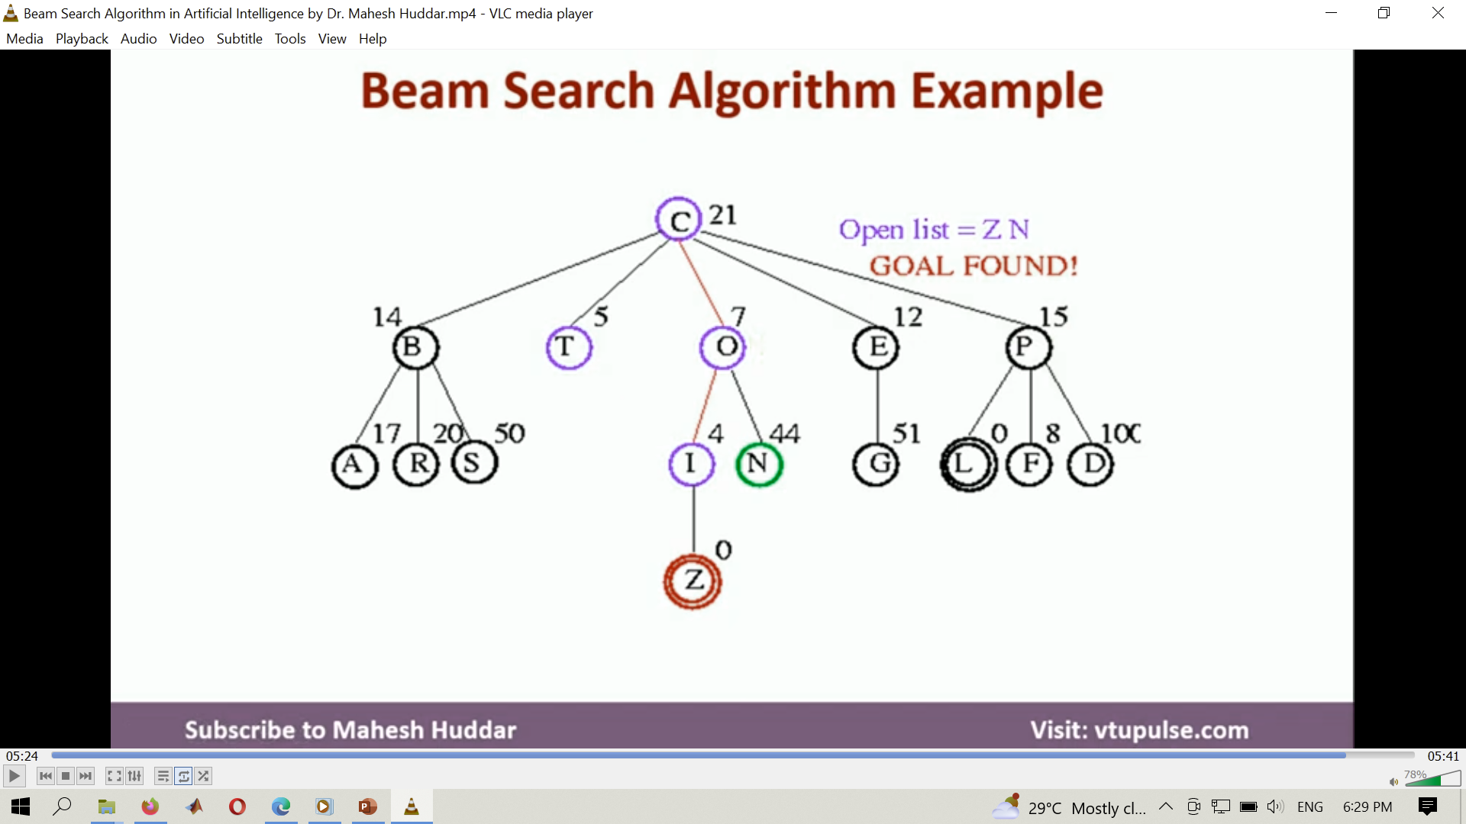
Beam search

Slide 46
real-life example
A real-life example of Beam Search in natural language processing is machine translation, where the goal is to translate a sentence from one language to another. Suppose we want to translate the English sentence "The cat is on the mat" to French.
To achieve this, we can use a machine translation model that takes the English sentence as input and outputs the corresponding French sentence. However, the model may generate multiple possible translations, and we need to select the most likely one.
During the translation process, the beam search algorithm works by generating multiple candidate translations at each step and retaining only the top "k" translations with the highest probabilities. These "k" translations are then used as the input for the next step, and the algorithm repeats this process until the end of the sentence is reached.
The beam search algorithm is used in this case to avoid generating incorrect translations by keeping track of the most probable sequence of translations. By retaining only, the top "k" translations, the algorithm avoids exploring all possible translations, which would be computationally expensive.
Beam Search can help improve the quality of machine translation by considering multiple possible translations at each time step and selecting the most likely one based on the model probability. The width of the beam can be adjusted to balance between accuracy and efficiency, where a wider beam may improve the accuracy but require more computational resources.

Slide 47
Genetic algorithms
Genetic algorithms is a population-based optimization algorithm that mimics the process of natural selection.
The algorithm starts with a population of candidate solutions and iteratively creates new solutions by recombining and mutating the existing ones.
The new solutions are then evaluated, and the fittest ones are selected to form the next generation.
Genetic algorithms can handle complex optimization problems but require a large number of evaluations.

Slide 48
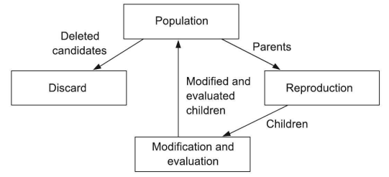
Genetic algorithms

Slide 49
A real life example
A real-life example of genetic algorithms search is in the field of robotics, particularly in the design of robot locomotion. In order to create a robot that can move in a desired way, engineers need to find the optimal combination of mechanical components and control algorithms that will produce the desired movement pattern.
This is where genetic algorithms come in. The engineer creates a virtual model of the robot and defines a set of parameters that can be adjusted, such as the length of the robot's legs or the timing of the control signals. The genetic algorithm then randomly generates a population of potential solutions, each with its own combination of parameter values.
The algorithm then evaluates each solution by simulating the robot's movement in a virtual environment and measuring how closely it matches the desired movement pattern. Solutions that perform poorly are discarded, while those that perform well are "bred" with each other, combining their parameter values to create new "offspring" solutions.
This process is repeated over many generations, with the best-performing solutions from each generation being selected for breeding in the next generation. Over time, the genetic algorithm converges on an optimal set of parameter values that produces the desired movement pattern.

Slide 50
Tabu Search
It is a neighborhood search algorithm that uses a tabu list to avoid revisiting recently visited solutions.
The algorithm starts with an initial solution and iteratively modifies it by exploring its neighborhood.
However, the algorithm avoids exploring the solutions that are on the tabu list to prevent revisiting recently visited solutions.
Tabu search can handle large search spaces but can get stuck in a local optimum.

Slide 51
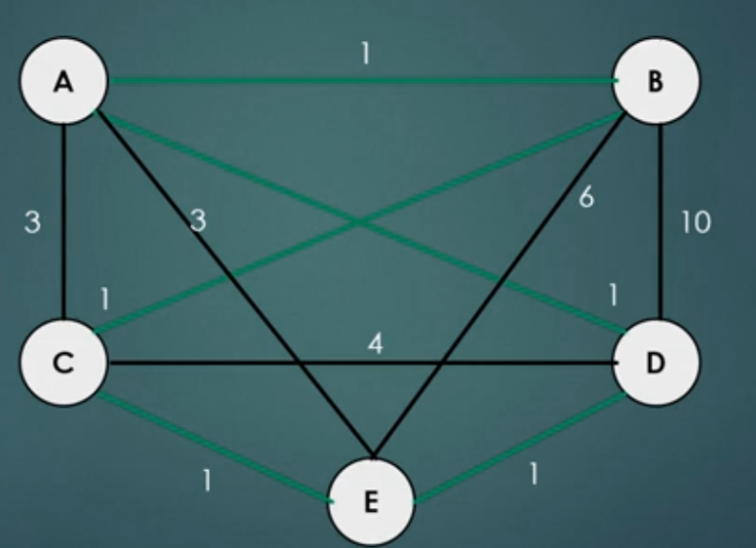
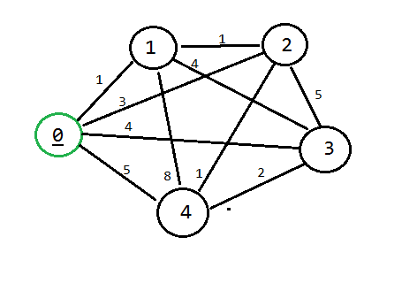
Tabu search

Slide 52
A real life example
One application of Tabu Search is in the field of vehicle routing. Vehicle routing involves determining the optimal routes for a fleet of vehicles to service a set of customers while minimizing costs such as travel time, distance, and fuel consumption.
Tabu Search can be used to solve vehicle routing problems by iteratively exploring different vehicle routes and evaluating their costs.
The algorithm starts with an initial solution, such as a randomly generated set of vehicle routes, and then makes incremental changes to it in order to improve its cost.
For example, let's say a company needs to optimize the delivery routes for their fleet of trucks.
The Tabu Search algorithm could be used to find the optimal routes by iteratively exploring different combinations of routes and evaluating their costs.
The algorithm would avoid returning to recently explored solutions, in order to ensure that it continues to explore new possibilities and does not get stuck in local optima.
The Tabu Search algorithm could also incorporate additional constraints, such as time windows for deliveries, vehicle capacity limits, and road restrictions, to ensure that the solutions generated are feasible and practical.
Tabu Search has been used successfully in a number of real-world vehicle routing applications, such as optimizing the routing of delivery trucks, garbage collection routes, and school bus routes.

Slide 53
Particle Swarm Optimization
Particle Swarm Optimization is a population-based optimization algorithm that simulates the behavior of a swarm of particles.
The algorithm starts with a population of particles and iteratively updates their positions based on their personal best and global best solutions.
The algorithm can converge quickly but can get stuck in a local optimum.

Slide 54
Particle Swarm Optimization

Slide 55
real-life application
One real-life application of PSO is in the field of power system optimization.
In a power system, there are often multiple sources of power, such as thermal, hydro, wind, and solar power, which need to be optimally coordinated to meet the demand while minimizing the cost of operation.
PSO can be used to solve power system optimization problems by iteratively exploring different combinations of power sources and evaluating their cost. The algorithm starts with a population of particles, each representing a potential solution, and updates their position and velocity in the search space based on their individual performance and the performance of the best solution found so far.
For example, let's say a power system operator needs to optimize the dispatch of power sources to meet the demand while minimizing the cost of operation. The PSO algorithm could be used to find the optimal combination of power sources by iteratively exploring different combinations and evaluating their cost.
The algorithm would update the position and velocity of each particle based on the best solution found so far, as well as the performance of the individual particle. The PSO algorithm can also incorporate additional constraints, such as power generation limits, transmission line capacities, and environmental regulations, to ensure that the solutions generated are feasible and practical.
PSO has been used successfully in several real-world power system optimization applications, such as optimizing the dispatch of power sources, scheduling the operation of hydroelectric power plants, and designing wind farm layouts.
By using PSO to optimize power system operation, companies can reduce their operating costs, improve the efficiency of their power generation, and minimize their environmental impact.

Slide 56

Performance measuring
Performance measuring is a crucial aspect of ML that helps to evaluate the accuracy and effectiveness of an ML model.
Performance measurement involves measuring different aspects of the model's performance and comparing them against a set of predefined metrics or standards.
The common methods for performance measuring in ML
Accuracy,
Precision,
F1 score,
Recall,
Area under curve (AUC),
mean square error(MSE),
Mean Absolute Error (MAE),
Receiver Operating Characteristic (ROC),
Confusion Matrix,
Cross-validation score.

Slide 57
Cont.
True Positives (TP)
The number of positive instances that the model correctly identifies.
False Positives (FP)
The number of negative instances that the model incorrectly identifies as positive.
True Negatives (TN)
The number of negative instances that the model correctly identifies.
False Negatives (FN)
The number of positive instances that the model incorrectly identifies as negative.

Slide 58
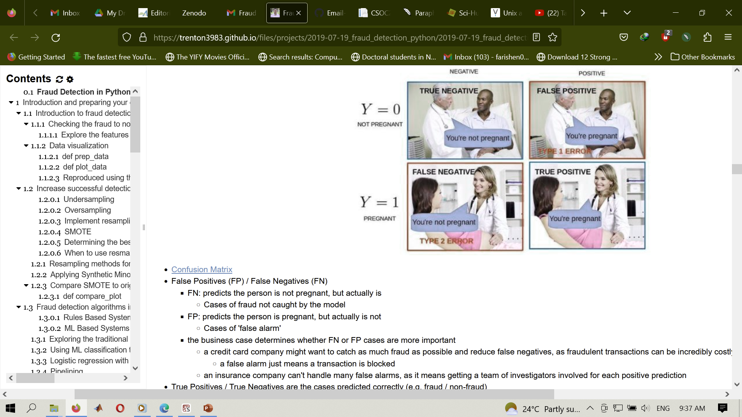
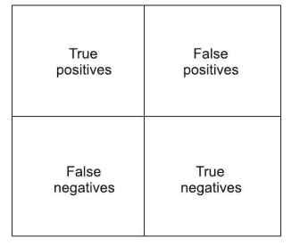
Confusion matrix

Slide 59
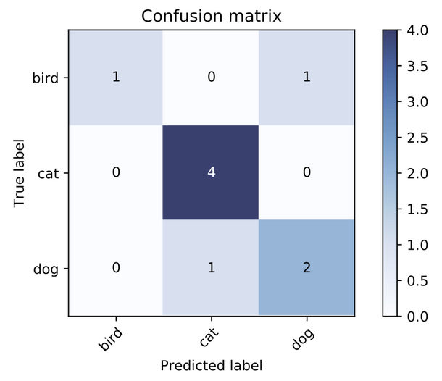
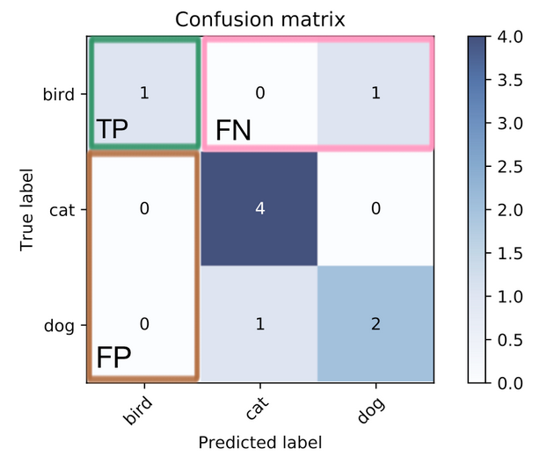
example

Slide 60
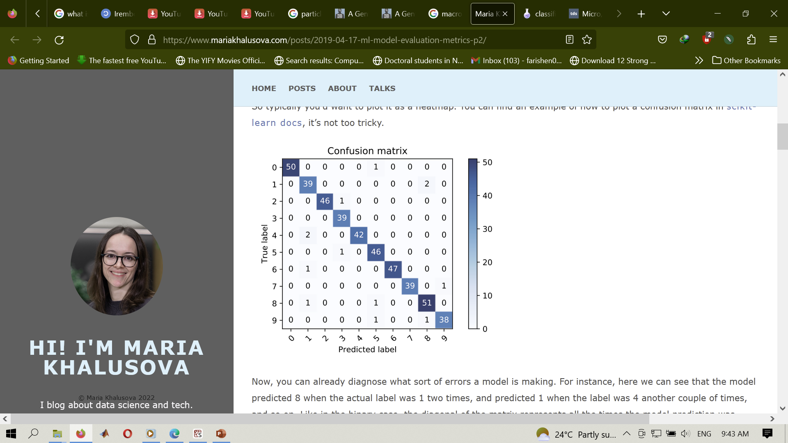
Cont.

Slide 61
Cont.
Accuracy
It measures the percentage of correct predictions made by the model on the test dataset.
Accuracy = (Number of Correct Predictions) / (Total Number of Predictions)
It is calculated as (TP + TN) / (TP + FP + TN + FN)
Precision
Precision measures the percentage of true positive predictions made by the model.
Precision = (True Positives) / (True Positives + False Positives)
It is calculated as TP / (TP + FP)
Recall
Recall measures the percentage of actual positive instances that the model correctly identified.
Recall = (True Positives) / (True Positives + False Negatives)
It is calculated as TP / (TP + FN).

Slide 62
Cont.
F1 Score
The F1 score is a combination of precision and recall that is used to measure the overall performance of the model.
It is calculated as: F1 Score = 2 * ((Precision * Recall) / (Precision + Recall))
Mean Squared Error (MSE)
MSE is a metric used for measuring the performance of regression models.
It calculates the average of the squared differences between the predicted values and the actual values.
It is calculated as MSE = (1/n) * Sum[(Predicted Value - Actual Value)^2]
Mean Absolute Error (MAE)
A common metric used in regression problems.
It measures the average absolute difference between the predicted and actual values of the target variable.

Slide 63
cont.
Area Under the Curve (AUC)
AUC is a popular metric for measuring the performance of a classification model.
It represents the area under the ROC curve, which plots the true positive rate against the false positive rate.
The higher the AUC, the better the performance of the model.
ROC Curve
A plot that shows the performance of a binary classifier model at various classification thresholds.
Cross-validation score
A technique used to evaluate the performance of a model on multiple subsets of the data.
It helps reduce the risk of overfitting and provides a more accurate estimate of the model's performance.
Confusion Matrix
A table that summarizes the performance of a classification model by comparing the predicted and actual labels.
It includes metrics such true positives, true negatives, false positives, and false negative

Slide 64
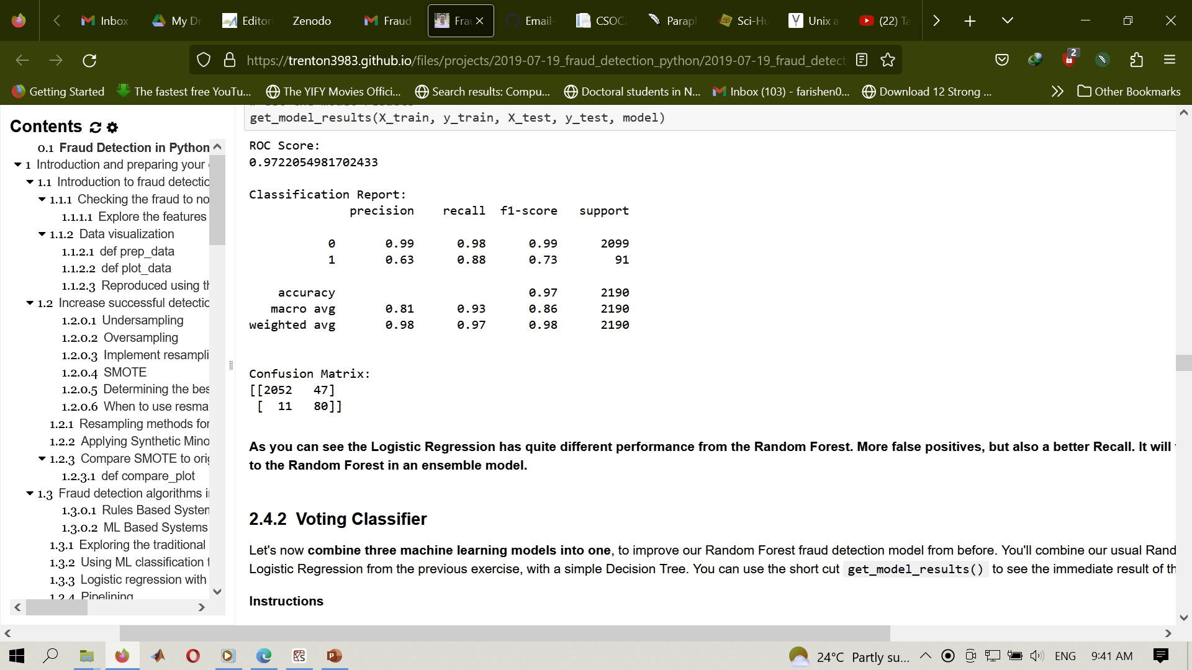
Classification report

Slide 65
Which average should I choose
Macro-Average:
In this approach, we calculate the metric for each class and then take the average of these values.
This method treats all classes equally, regardless of their frequency or imbalance.
It's appropriate to use macro-average when we want to evaluate the model's performance on each class separately and ensure that none of the classes dominate the final evaluation.
In general, if you are working with an imbalanced dataset where all classes are equally important, using the macro average would be a good choice as it treats all classes equally.

Slide 66
Cont.
Weighted Average:
In this approach, we calculate the metric for each class and then weight them by their relative frequency or proportion.
This method takes into account the imbalance in the class distribution and is appropriate when we want to evaluate the model's overall performance while giving more weight to the classes with more samples.
In conclusion, we should use the macro-average when we want to evaluate the model's performance on each class separately, and the weighted average when we want to give more importance to the classes with more samples.

Slide 67
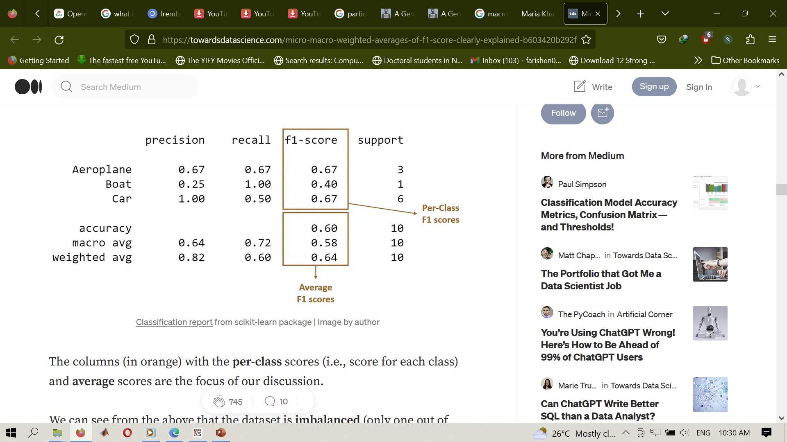
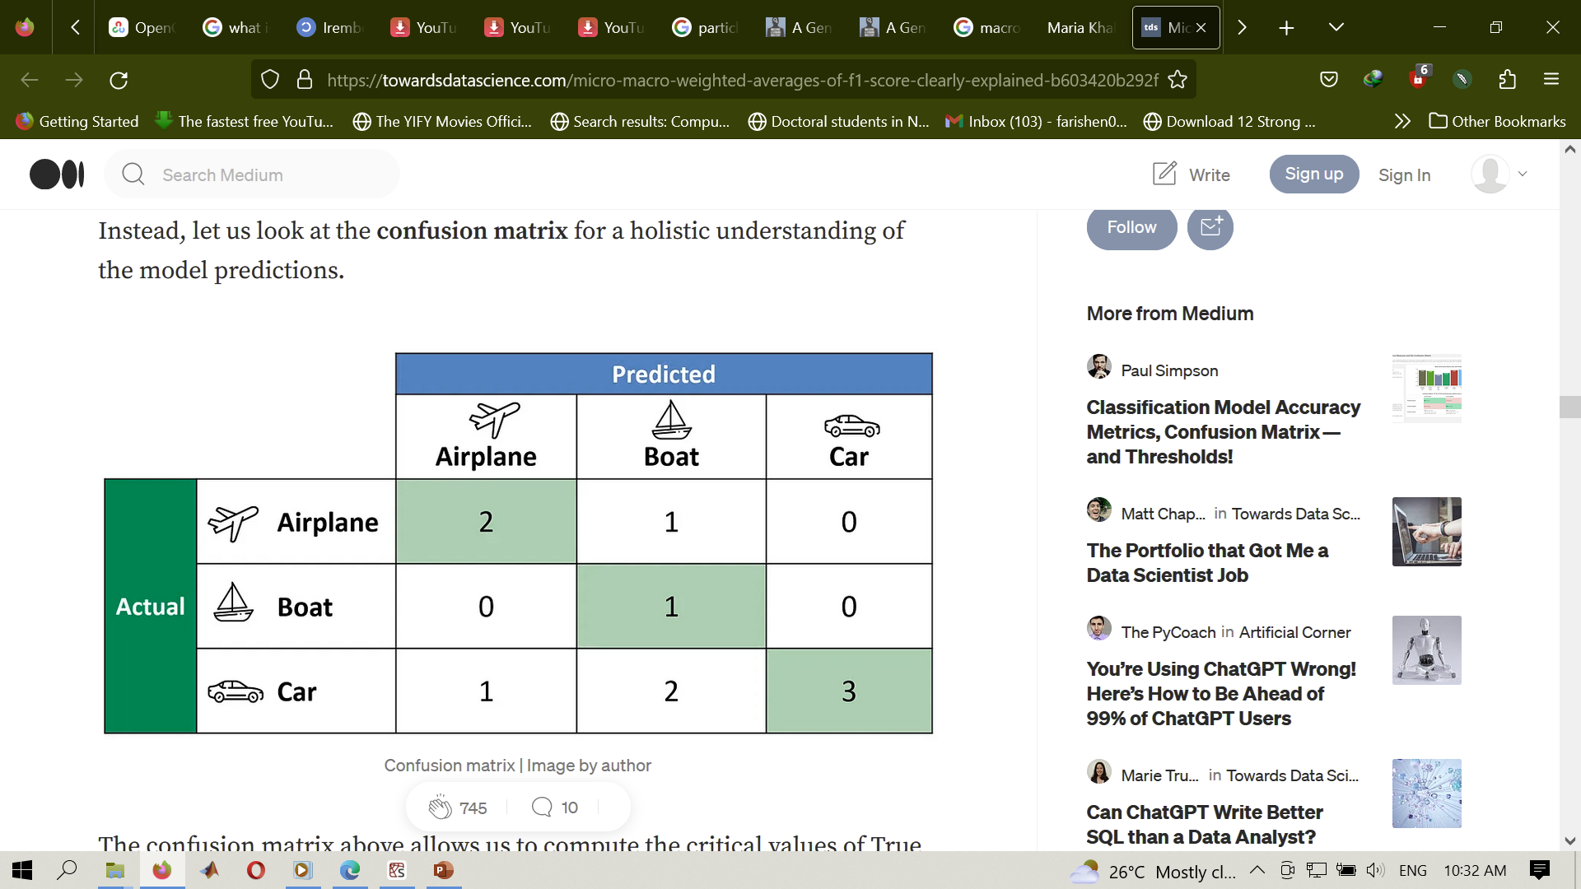
Example

Slide 68
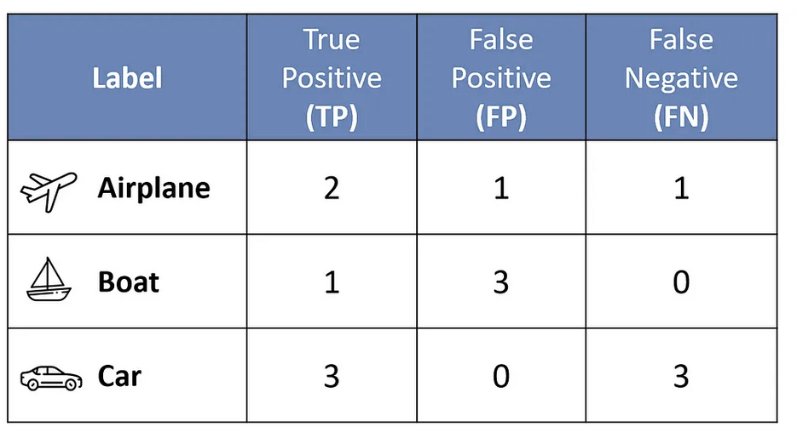
summary

Slide 69

End.

